Slide 1
Coding Challenge #1: RPC Service
An asynchronous RPC service and client that communicate over a message bus.

Slide 2
Components
RPC Server
Listens for messages from clients over a Message Bus
Accepts a mathematical statement string as an input
Parses the statement using recursive descent parsing
Returns the evaluated statement value (if no errors)
An error if the statement cannot be parsed as per the grammar
RPC Client
Sends a message to the RPC Server over a Message Bus
The message contains a mathematical statement to be evaluated
Prints result or an error and shuts down
Message Bus
A generic Message Bus interface
A default implementation using RabbitMQ Message Queue
Only the interface is exposed to the outside world (RPC Server and Client)
Extensible to use any other Message Queue implementation in the future

Slide 3
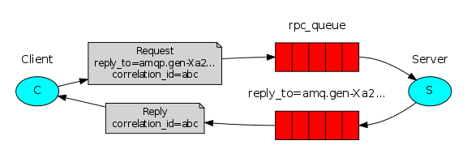
Message exchange using RabbitMQ
Source: https://www.rabbitmq.com/tutorials/tutorial-six-java.html

Slide 4
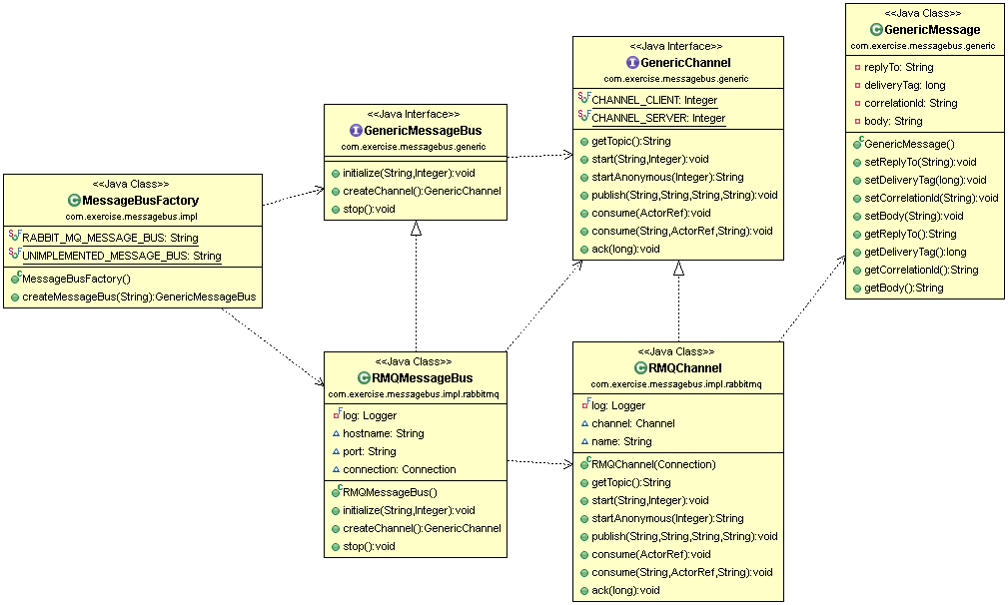
Generic Message Bus Classes

Slide 5
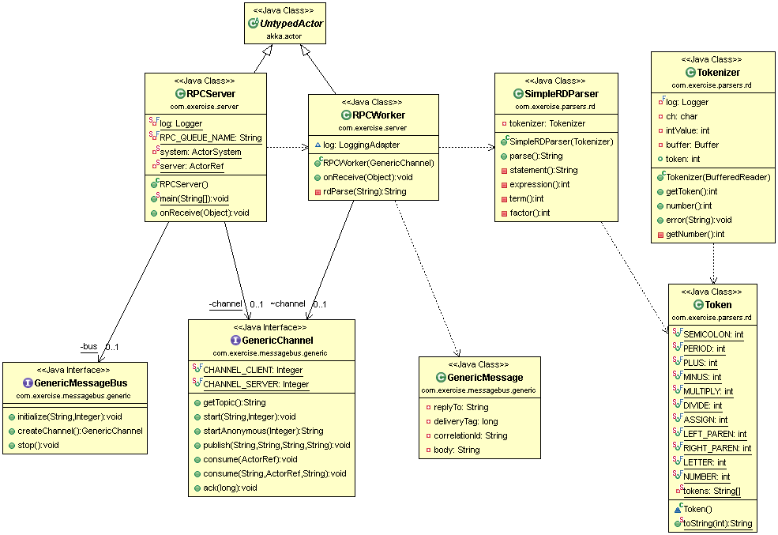
RPC Server Classes

Slide 6
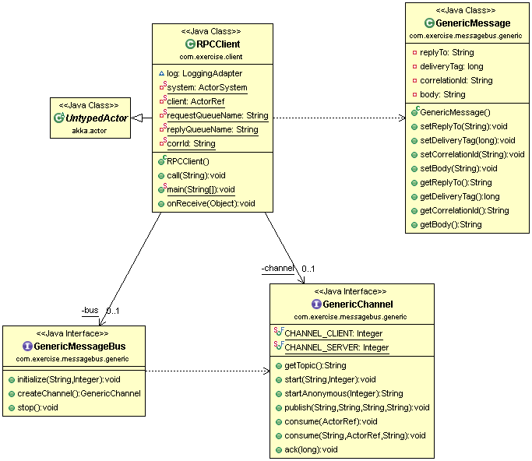
RPC Client Classes

Slide 7
Parser Grammar
Statement = Expression { "=""=" Expression } “;” “.”
Expression = Term “+” | “-” Term
Term = Factor “*” | “/” Factor
Factor = NUMBER | “(“ Expression “)”
Examples:
3+9-2*4/2 (result: 8)
3+(9-2)*4/2 (result: 17)
3+(9-2)*4/2 == 3+9-2*4/2 (result: false)
3+9-2*4/2 == 8 (result: true)
2 = = 2 (result: Exception; there is a space between the two ‘=‘)

Slide 8
Build Tool and Libraries Used
Maven based project (Archetype: jar)
RabbitMQ (amqp-client): For implementing a reliable message bus
Akka Actors (akka-actor): For asynchronous programming
SLF4J Logger (logback-classic): For logback configured logging
Junit: For unit testing

Slide 9
Build and Run Instructions
Pull the following projects from the GitHub link (https://github.com/chavalipraveen/CodingExerciseAsyncRPCClientServer)
GenericMessageBus
RPCServer
RPCClient
Run “mvn install” in each of the project directories (GenericMessageBus needs to be built first)
Start the RPC Server
Set the classpath to the dependent libraries and the target/classes directory
java com.exercise.server.RPCServer
Run the RPC Client
Set the classpath to the dependent libraries and the target/classes directory
java com.exercise.client.RPCClient 2+(8-3)*6/2;. (end the statement with a “;” followed by “.”)

Slide 10
Questions and Comments

